Slide 1
Linear System of Equations: Conditioning

Slide 3
Numerical experiments
Input has uncertainties:
Errors due to representation with finite precision
Error in the sampling
Once you select your numerical method , how much error should you expect to see in your output?
Is your method sensitive to errors (perturbation) in the input?
Demo “HilbertMatrix-ConditionNumber”

Slide 4
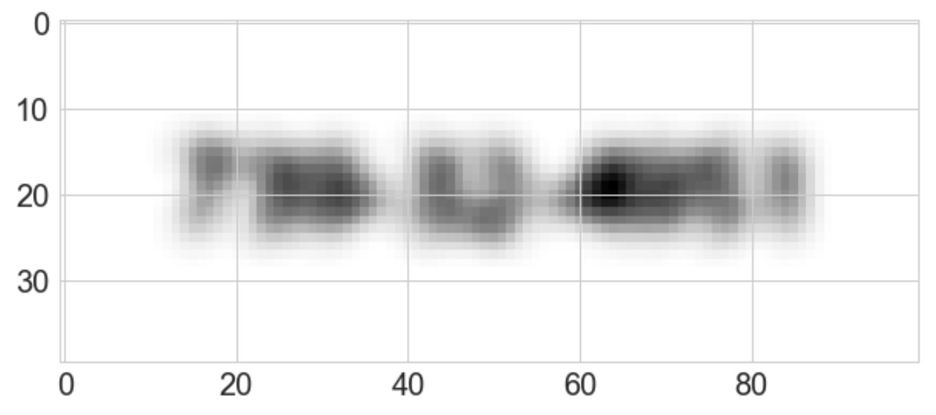

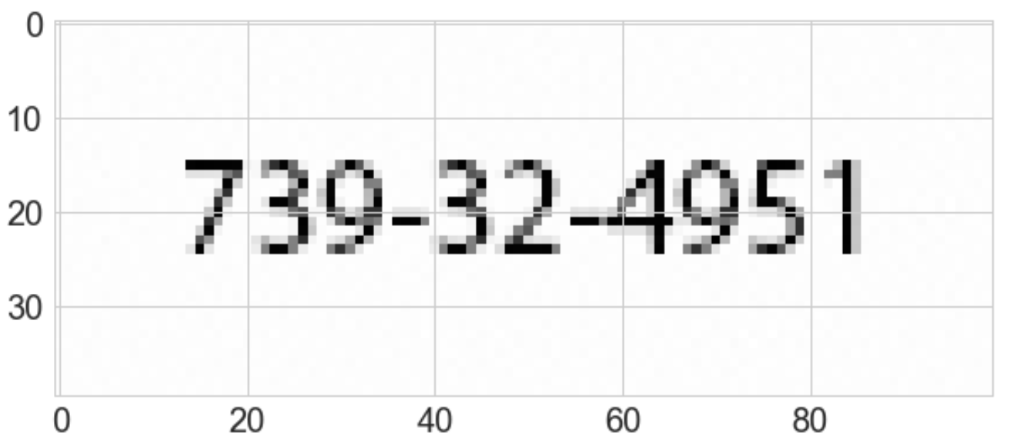
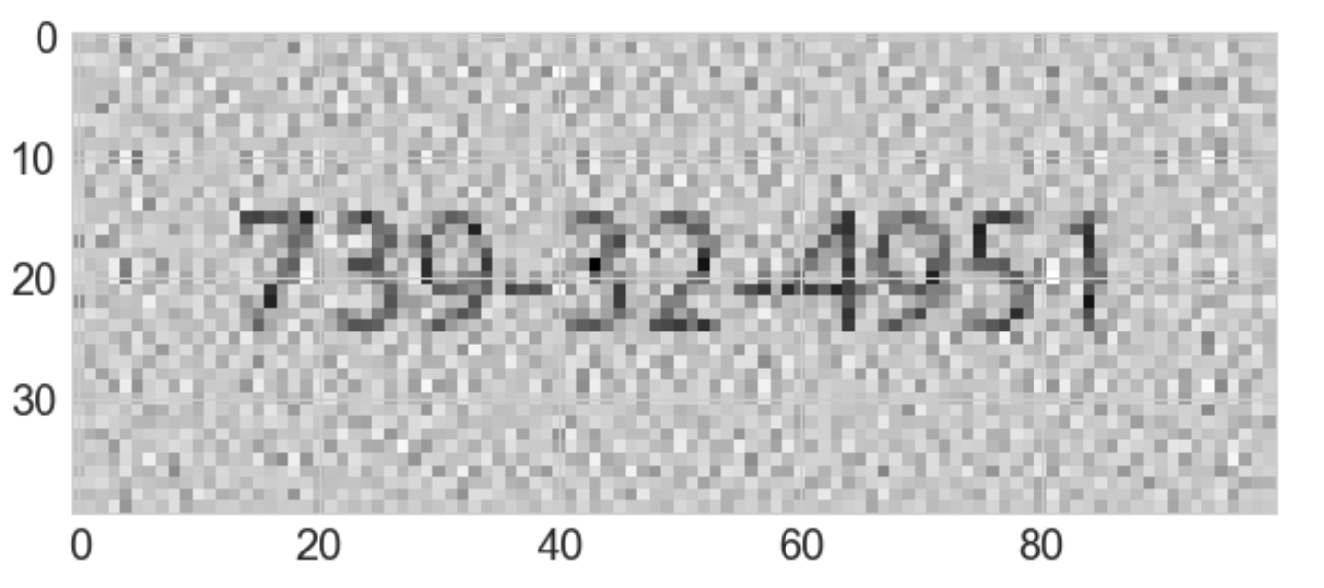
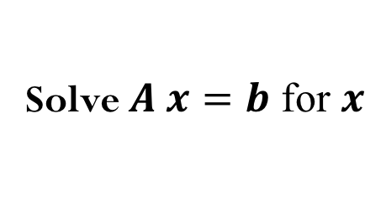
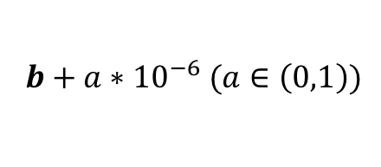
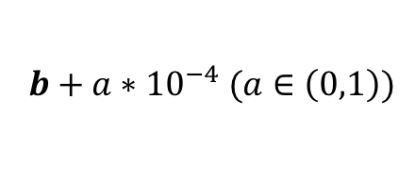
$$b+{a∗10}^{−6} (a∈\left(0,1\right))$$
$$b+{a∗10}^{−4} (a∈\left(0,1\right))$$
Solve $A x=b$ for $x$
Is your method sensitive to errors (perturbation) in the input?
How much noise can we add to the input data?
How can we define “little” amount of noise? Should be relative with the magnitude of the data.
Notes:
What is the x that satisfies Ax=b? What are the input to this problem?
Input data are A and b.
We add noise in b and how much noise do we see in the solution x?
Suppose the matrix A had noise. How much should we expect in the solution x?

Slide 5
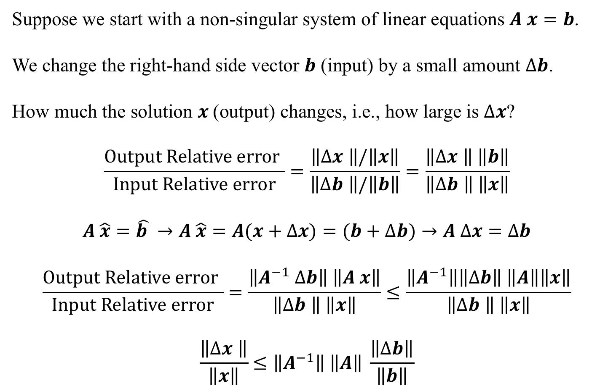
Sensitivity of Solutions of Linear Systems
Suppose we start with a non-singular system of linear equations $A x=b$.
We change the right-hand side vector $b$ (input) by a small amount $Δb$.
How much the solution $x$(output) changes, i.e., how large is $Δx$?
$$\frac{Output Relative error }{Input Relative error}=\frac{\left\|Δx \right\|/\left\|x\right\|}{\left\|Δb \right\|/\left\|b\right\|}=\frac{\left\|Δx \right\| \left\|b\right\|}{\left\|Δb \right\| \left\|x\right\|}$$
$$A \hat{x}=\hat{b }→A \hat{x}=A(x+Δx)=(b+Δb)→A Δx=Δb$$
$$\frac{Output Relative error }{Input Relative error}=\frac{\left\|A^{−1} Δb\right\| \left\|A x\right\|}{\left\|Δb \right\| \left\|x\right\|}≤\frac{\left\|A^{−1}\right\|\left\|Δb\right\| \left\|A\right\|\left\|x\right\|}{\left\|Δb \right\| \left\|x\right\|}$$
$$\frac{\left\|Δx \right\|}{\left\|x\right\|}≤\left\|A^{−1}\right\| \left\|A\right\| \frac{\left\|Δb\right\|}{\left\|b\right\|}$$

Slide 6
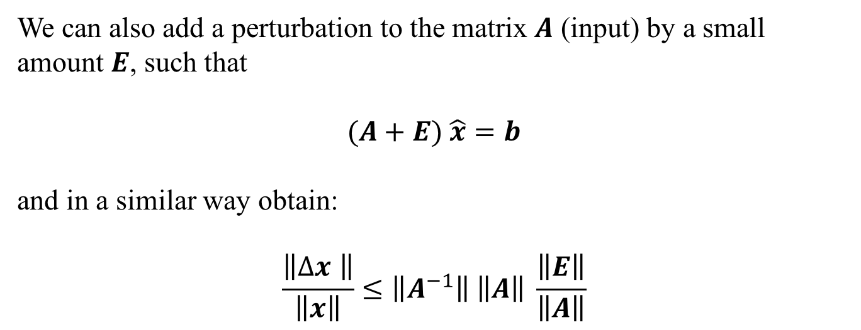
Sensitivity of Solutions of Linear Systems
We can also add a perturbation to the matrix $A$ (input) by a small amount $E$, such that
$$(A+E) \hat{x}=b$$
and in a similar way obtain:
$$\frac{\left\|Δx \right\|}{\left\|x\right\|}≤\left\|A^{−1}\right\| \left\|A\right\| \frac{\left\|E\right\|}{\left\|A\right\|}$$

Slide 7
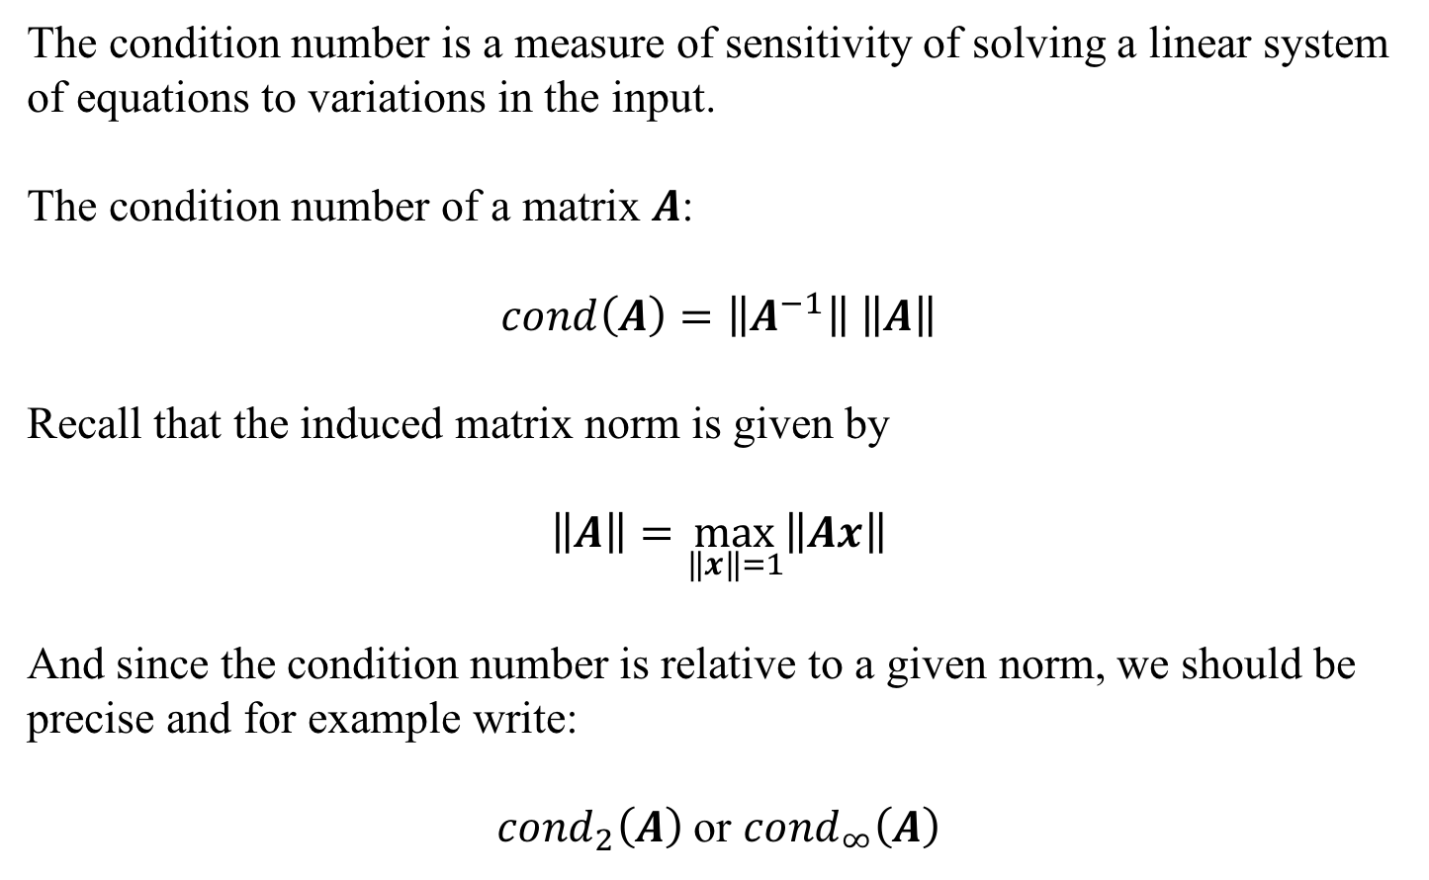
Demo “HilbertMatrix-ConditionNumber”
Condition number
The condition number is a measure of sensitivity of solving a linear system of equations to variations in the input.
The condition number of a matrix $A$:
$$cond\left(A\right)=\left\|A^{−1}\right\| \left\|A\right\|$$
Recall that the induced matrix norm is given by
$$\left\|A\right\|=\max_{\left\|x\right\|=1}\left\|Ax\right\|$$
And since the condition number is relative to a given norm, we should be precise and for example write:
${cond}_{2}\left(A\right)$ or ${cond}_{∞}\left(A\right)$

Slide 8
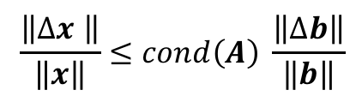
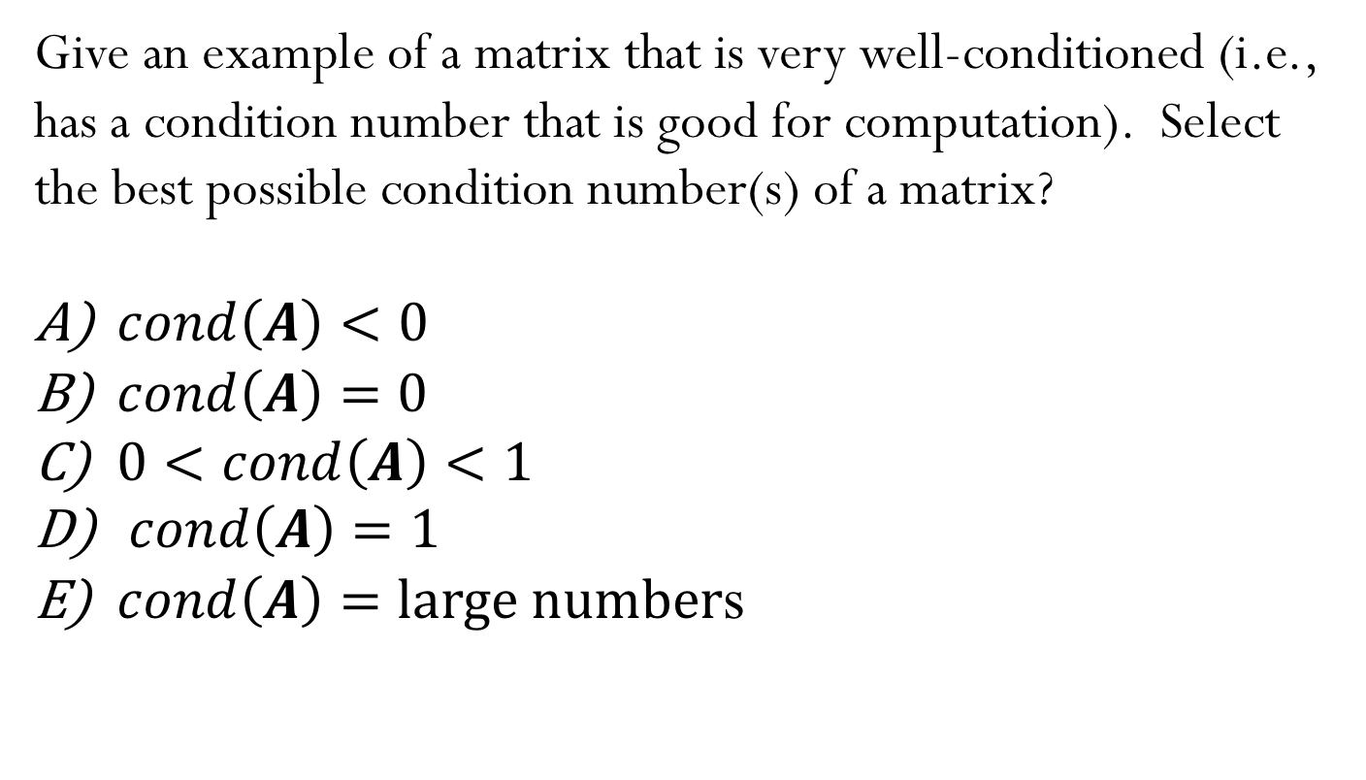
Iclicker question
$$\frac{\left\|Δx \right\|}{\left\|x\right\|}≤cond\left(A\right) \frac{\left\|Δb\right\|}{\left\|b\right\|}$$
Give an example of a matrix that is very well-conditioned (i.e., has a condition number that is good for computation). Select the best possible condition number(s) of a matrix?
$cond\left(A\right)<0$
$cond\left(A\right)=0$
$0<cond\left(A\right)<1$
$cond\left(A\right)=1$
$cond\left(A\right)=large number$s

Slide 9
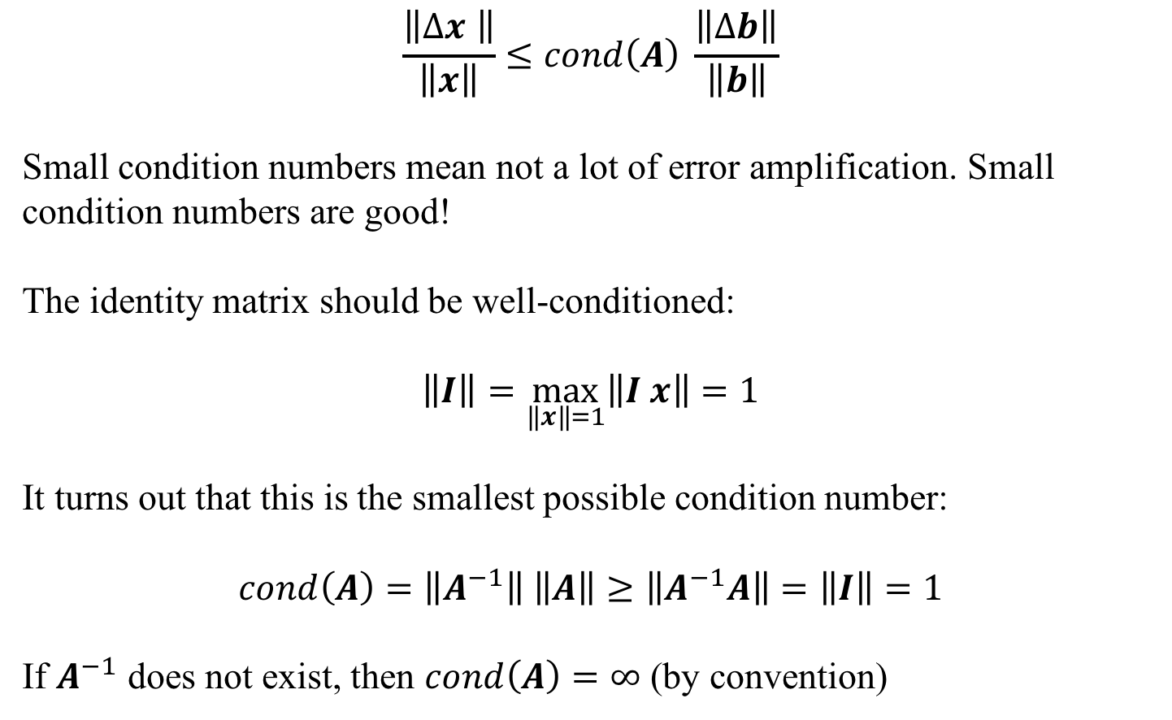
Condition number
$$\frac{\left\|Δx \right\|}{\left\|x\right\|}≤cond\left(A\right) \frac{\left\|Δb\right\|}{\left\|b\right\|}$$
Small condition numbers mean not a lot of error amplification. Small condition numbers are good!
The identity matrix should be well-conditioned:
$$\left\|I\right\|=\max_{\left\|x\right\|=1}\left\|I x\right\|=1$$
It turns out that this is the smallest possible condition number:
$$cond\left(A\right)=\left\|A^{−1}\right\| \left\|A\right\|≥\left\|A^{−1}A\right\|=\left\|I\right\|=1$$
If $A^{−1}$ does not exist, then $cond\left(A\right)=∞$ (by convention)

Slide 10
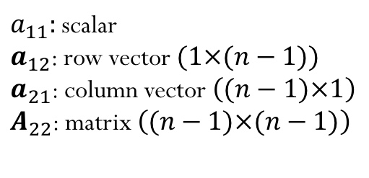
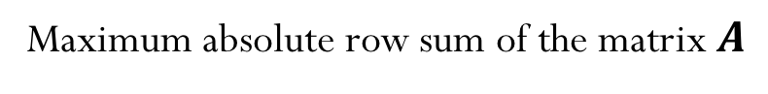
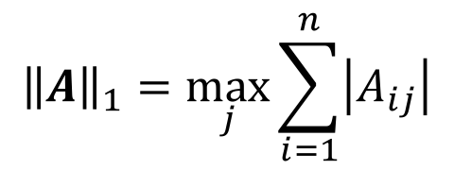
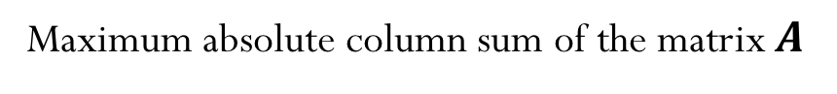
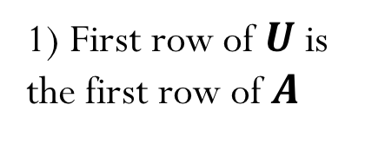
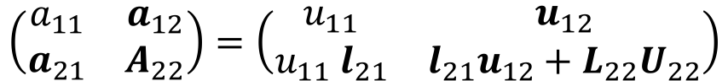
Recall Induced Matrix Norms
$${\left\|A\right\|}_{1}=\max_{j}{\sum_{i=1}^{n}{\left|A_{ij}\right|}}$$
Maximum absolute column sum of the matrix $A$
$${\left\|A\right\|}_{∞}=\max_{i}{\sum_{j=1}^{n}{\left|A_{ij}\right|}}$$
Maximum absolute row sum of the matrix $A$
$${\left\|A\right\|}_{2}=\max_{k}{σ_{k}}$$
$σ_{k}$ are the singular value of the matrix $A$

Slide 11
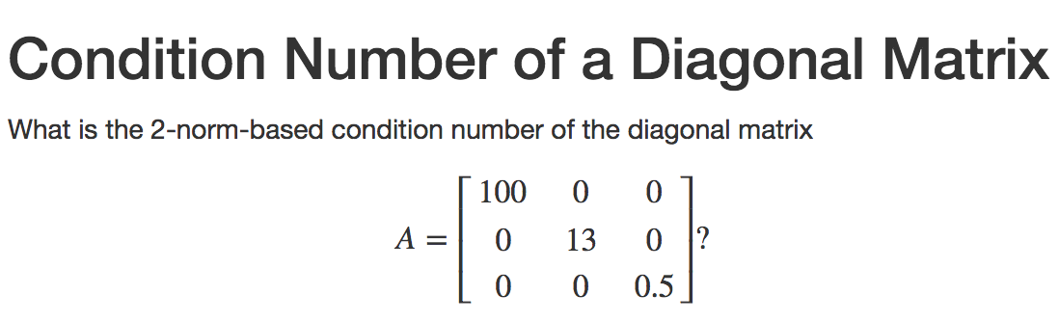
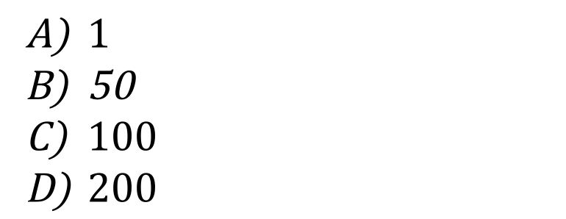
Iclicker question
$1$
50
$100$
$200$

Slide 12
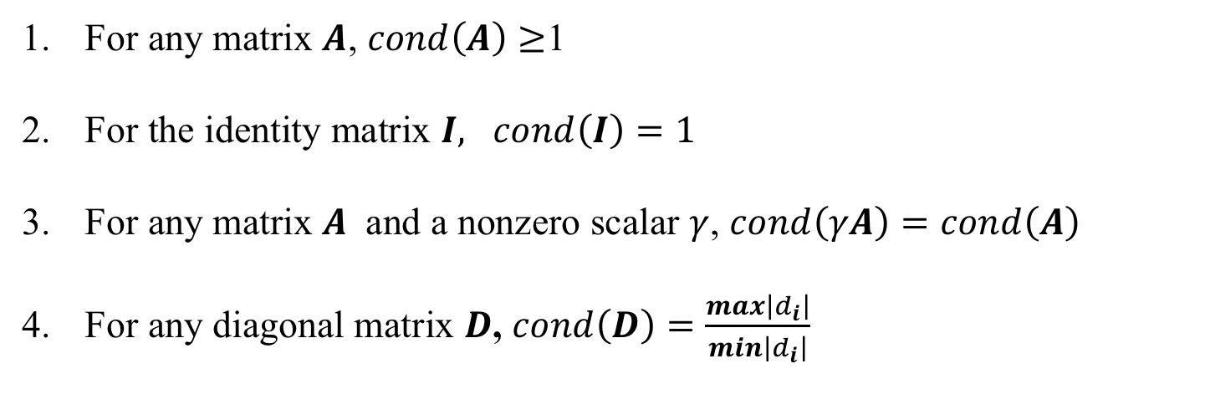
About condition numbers
For any matrix $A$, $cond\left(A\right)≥$1
For the identity matrix $I, cond\left(I\right)=1$
For any matrix $A$ and a nonzero scalar $γ$, $cond\left(γA\right)=cond\left(A\right)$
For any diagonal matrix $D$, $cond\left(D\right)=\frac{max\left|d_{i}\right|}{min\left|d_{i}\right|}$

Slide 13
“Little c” demo
Discuss what happens when c is ”close” to zero
What are the eigenvalues of triangular matrices?
We need to pivot!
Remarks:
The need for pivoting does not depend on whether the matrix is singular.
A non-singular matrix always has a solution.
A singular matrix may not have a solution, or may have infinitely many solutions.

Slide 14
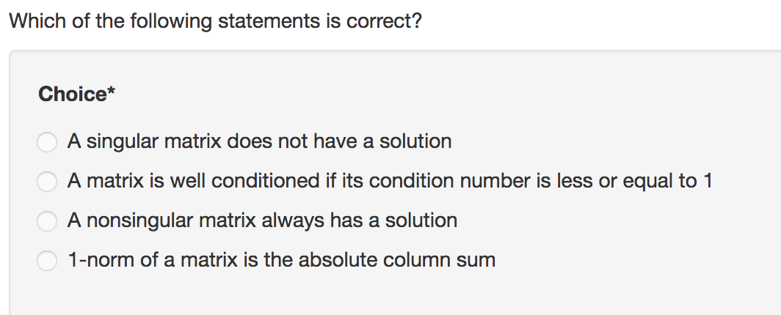
Iclicker question
The need for pivoting depends on whether the matrix is singular.
True
False
A)
B)
C)
D)

Slide 15
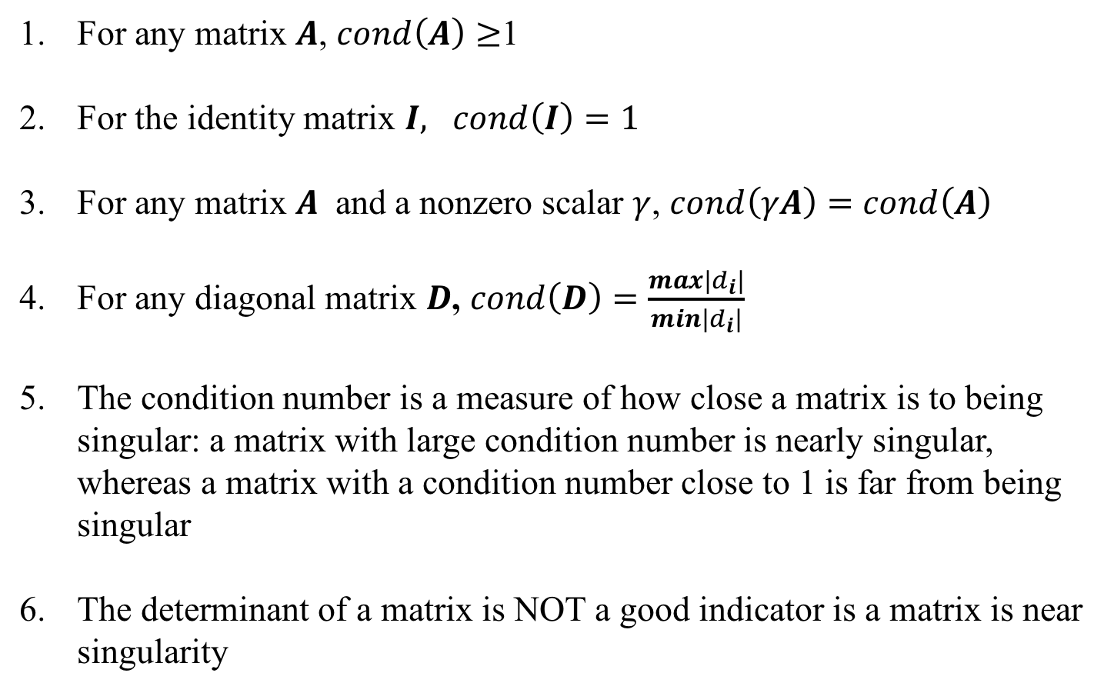
About condition numbers
For any matrix $A$, $cond\left(A\right)≥$1
For the identity matrix $I, cond\left(I\right)=1$
For any matrix $A$ and a nonzero scalar $γ$, $cond\left(γA\right)=cond\left(A\right)$
For any diagonal matrix $D$, $cond\left(D\right)=\frac{max\left|d_{i}\right|}{min\left|d_{i}\right|}$
The condition number is a measure of how close a matrix is to being singular: a matrix with large condition number is nearly singular, whereas a matrix with a condition number close to 1 is far from being singular
The determinant of a matrix is NOT a good indicator is a matrix is near singularity

Slide 16
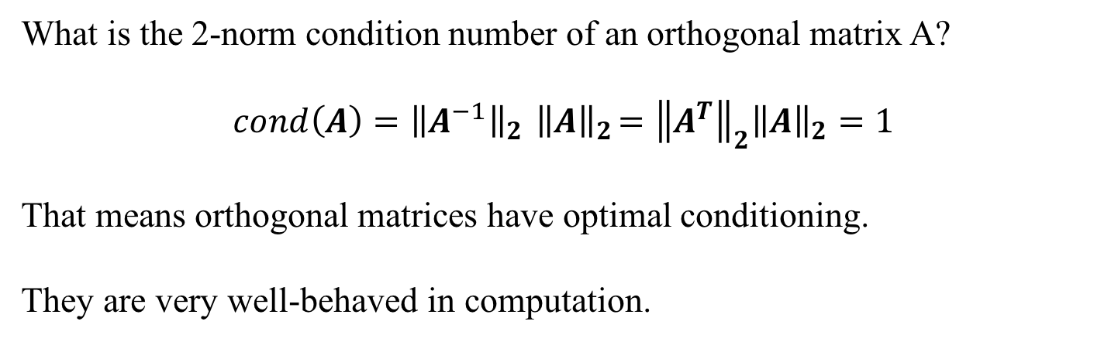
Condition Number of Orthogonal Matrices
What is the 2-norm condition number of an orthogonal matrix A?
$$cond\left(A\right)={\left\|A^{−1}\right\|}_{2}{ \left\|A\right\|}_{2}={\left\|A^{T}\right\|}_{2}{\left\|A\right\|}_{2}=1$$
That means orthogonal matrices have optimal conditioning.
They are very well-behaved in computation.

Slide 17
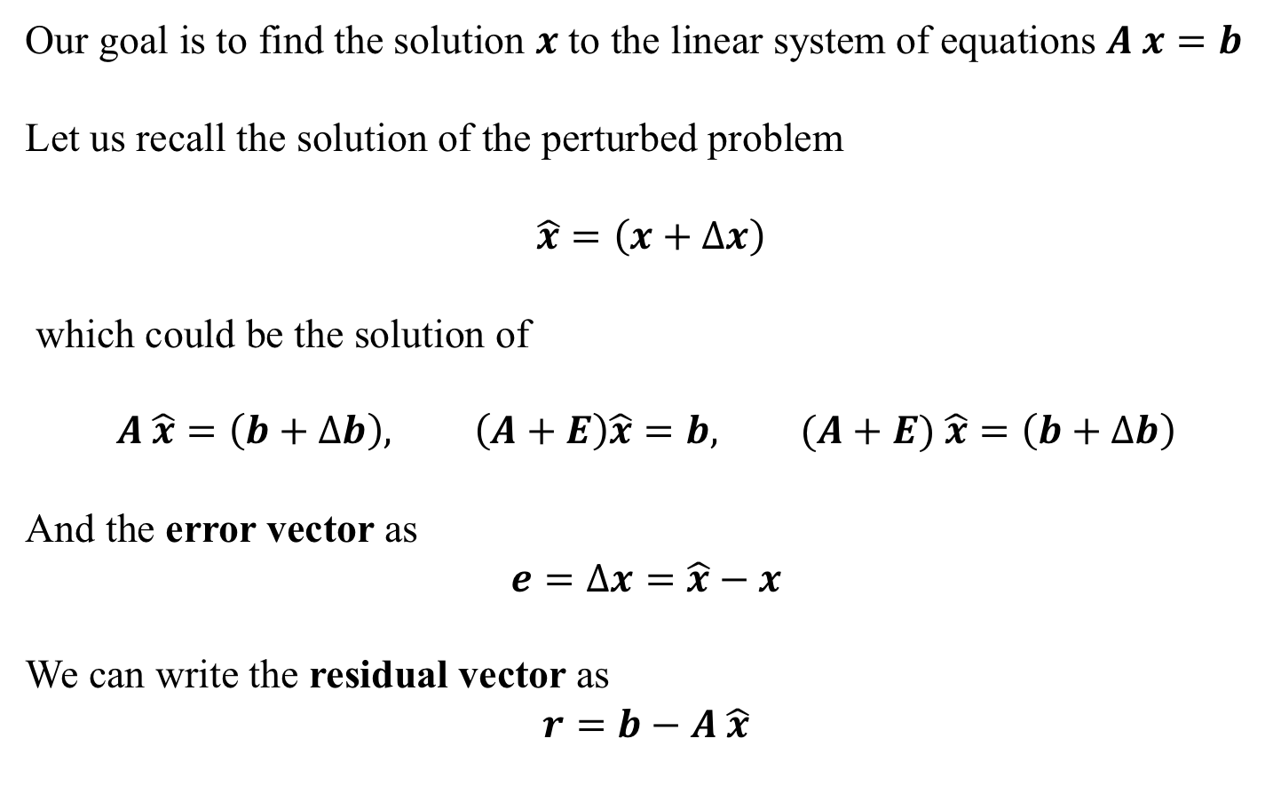
Residual versus error
Our goal is to find the solution $x$ to the linear system of equations $A x=b$
Let us recall the solution of the perturbed problem
$\hat{x}=\left(x+Δx\right)$
which could be the solution of
$$A \hat{x}=\left(b+Δb\right), \left(A+E\right)\hat{x}=b, (A+E) \hat{x}=\left(b+Δb\right)$$
And the error vector as
$$e=Δx=\hat{x}−x$$
We can write the residual vector as
$$r=b−A \hat{x}$$

Slide 18
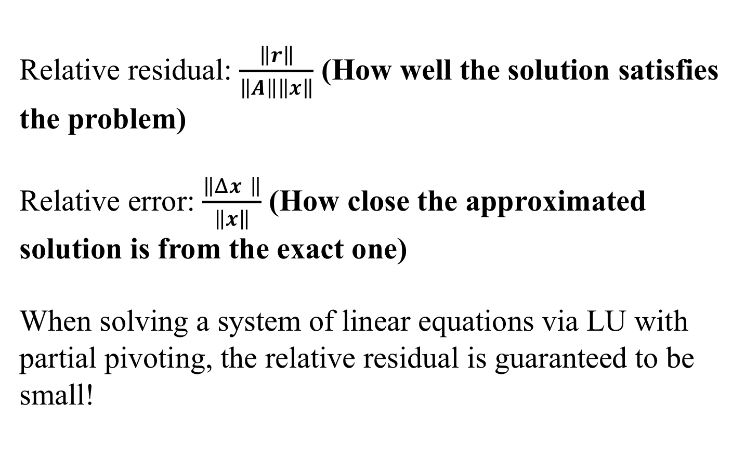
Demo “Rule of Thumb on Conditioning”
Relative residual: $\frac{\left\|r\right\|}{\left\|A\right\|\left\|x\right\|}$ (How well the solution satisfies the problem)
Relative error: $\frac{\left\|Δx \right\|}{\left\|x\right\|}$ (How close the approximated solution is from the exact one)
When solving a system of linear equations via LU with partial pivoting, the relative residual is guaranteed to be small!
Notes:
Residual: how well the solution satisfies the problem
Error: how close the solution is to the approximate one

Slide 19
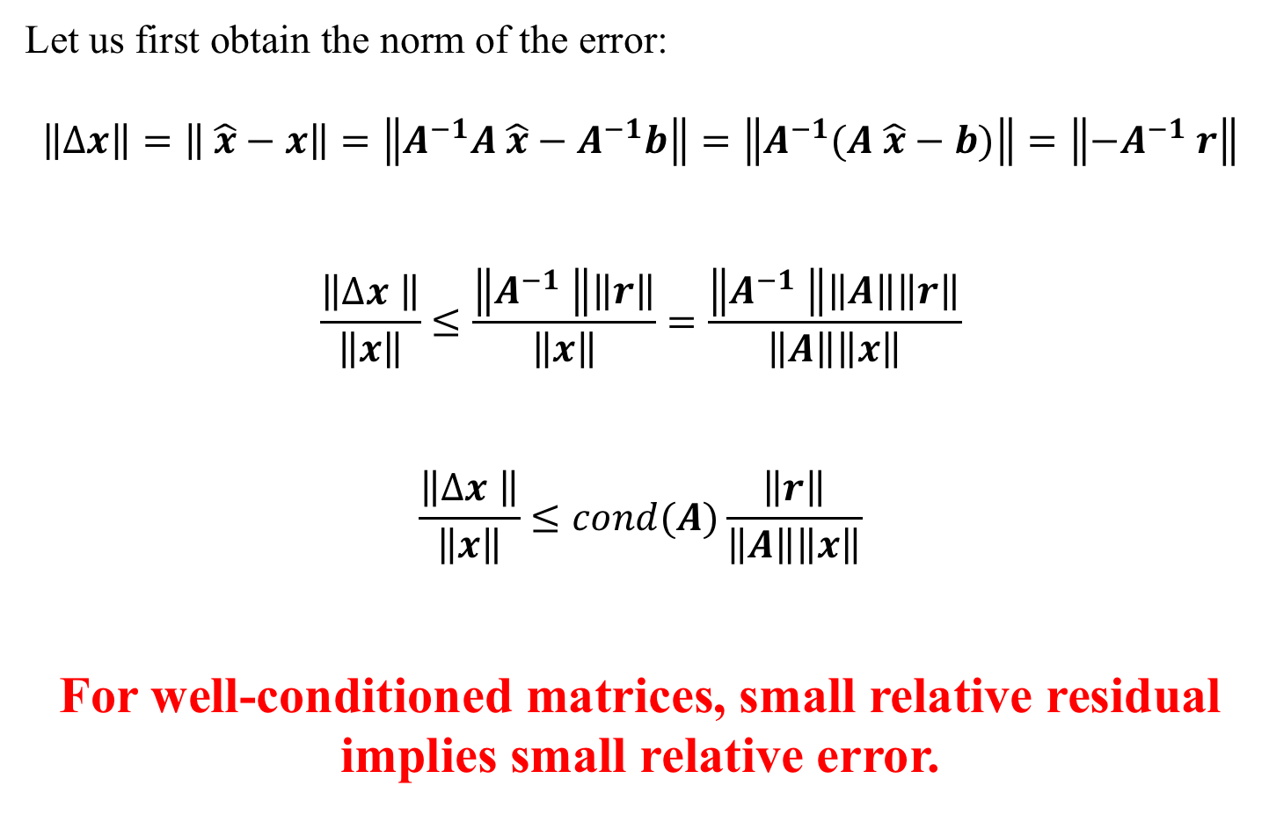
Residual versus error
Let us first obtain the norm of the error:
$$\left\|Δx\right\|=\left\| \hat{x}−x\right\|=\left\|A^{−1}A \hat{x}−A^{−1}b\right\|=\left\|A^{−1}(A \hat{x}−b)\right\|=\left\|{−A}^{−1} r\right\|$$
$$\frac{\left\|Δx \right\|}{\left\|x\right\|}≤\frac{\left\|A^{−1} \right\|\left\|r\right\|}{\left\|x\right\|}=\frac{\left\|A^{−1} \right\|\left\|A\right\|\left\|r\right\|}{\left\|A\right\|\left\|x\right\|}$$
$$\frac{\left\|Δx \right\|}{\left\|x\right\|}≤cond(A)\frac{\left\|r\right\|}{\left\|A\right\|\left\|x\right\|}$$
For well-conditioned matrices, small relative residual implies small relative error.

Slide 20
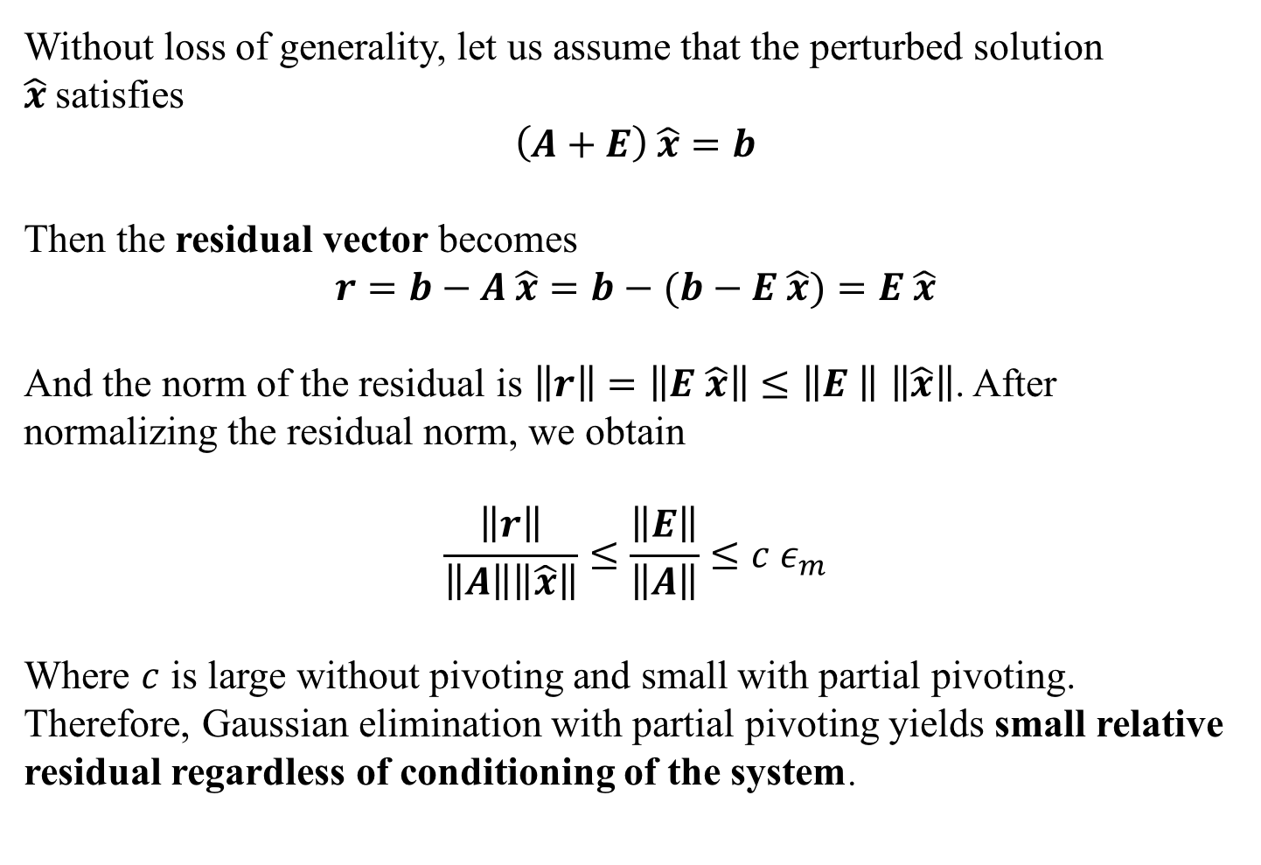
Residual versus error
Without loss of generality, let us assume that the perturbed solution $\hat{x}$satisfies
$$\left(A+E\right) \hat{x}=b$$
Then the residual vector becomes
$$r=b−A \hat{x}=b−(b−E \hat{x})=E \hat{x}$$
And the norm of the residual is $\left\|r\right\|=\left\|E \hat{x}\right\|≤\left\|E \right\|$ $\left\|\hat{x}\right\|$. After normalizing the residual norm, we obtain
$$\frac{\left\|r\right\|}{\left\|A\right\|\left\|\hat{x}\right\|}≤\frac{\left\|E\right\|}{\left\|A\right\|}≤c ε_{m}$$
Where $c$ is large without pivoting and small with partial pivoting. Therefore, Gaussian elimination with partial pivoting yields small relative residual regardless of conditioning of the system.

Slide 21
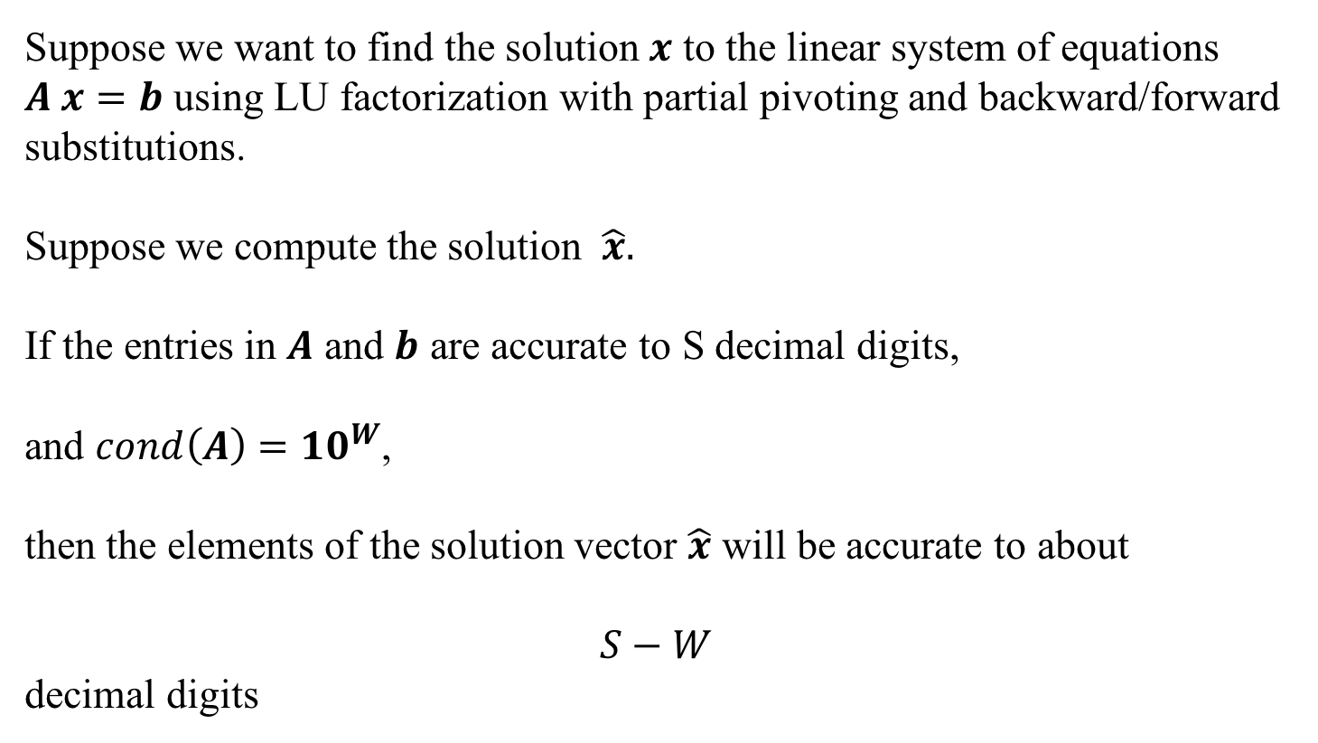
Rule of thumb for conditioning
Suppose we want to find the solution $x$ to the linear system of equations $A x=b$ using LU factorization with partial pivoting and backward/forward substitutions.
Suppose we compute the solution $\hat{x}.$
If the entries in $A$ and $b$ are accurate to S decimal digits,
and $cond\left(A\right)={10}^{W}$,
then the elements of the solution vector $\hat{x}$ will be accurate to about
$$S−W$$
decimal digits
Notes:
ADD MORE HERE ABOUT THE RULE OF THUMB, and how it can be related with the relationship between sig.fig and relative error

Slide 22
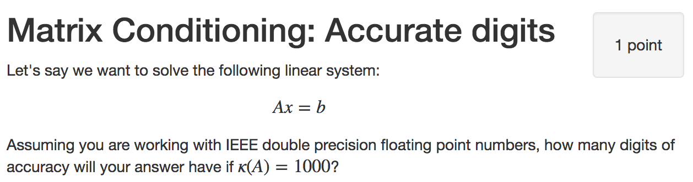
Iclicker question
3
10
13
16
32
Notes:
13

Slide 23
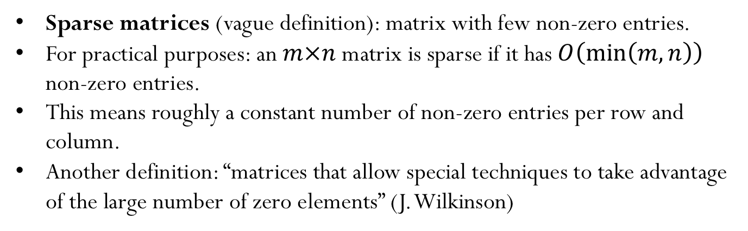
Sparse Matrices
Some type of matrices contain many zeros. Storing all those zero entries is wasteful!
How can we efficiently store large matrices without storing tons of zeros?
Sparse matrices (vague definition): matrix with few non-zero entries.
For practical purposes: an $m×n$matrix is sparse if it has $O\left(\min\left(m,n\right)\right)$ non-zero entries.
This means roughly a constant number of non-zero entries per row and column.
Another definition: “matrices that allow special techniques to take advantage of the large number of zero elements” (J. Wilkinson)

Slide 24
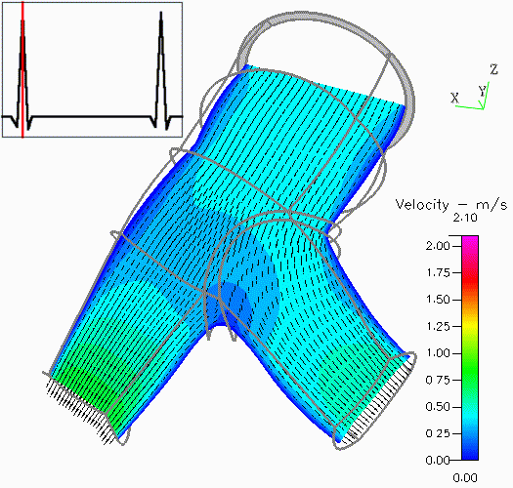
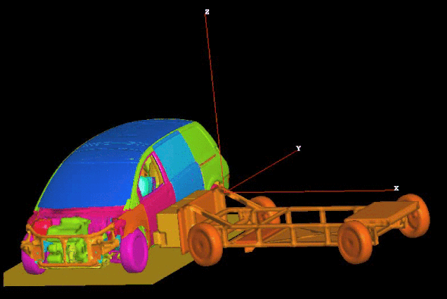
Sparse Matrices: Goals
Perform standard matrix computations economically, i.e., without storing the zeros of the matrix.
For typical Finite Element and Finite Difference matrices, the number of non-zero entries is $O\left(n\right)$

Slide 25
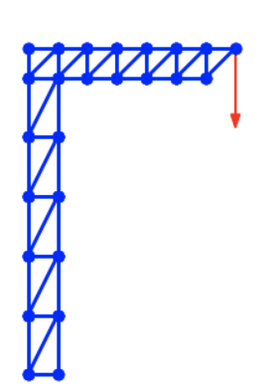
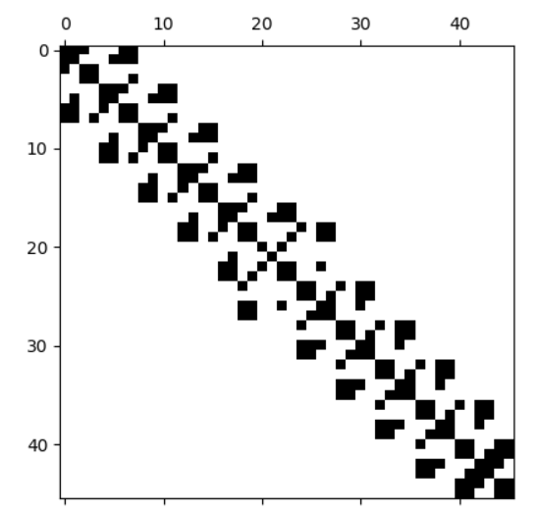
Sparse Matrices: MP example

Slide 26
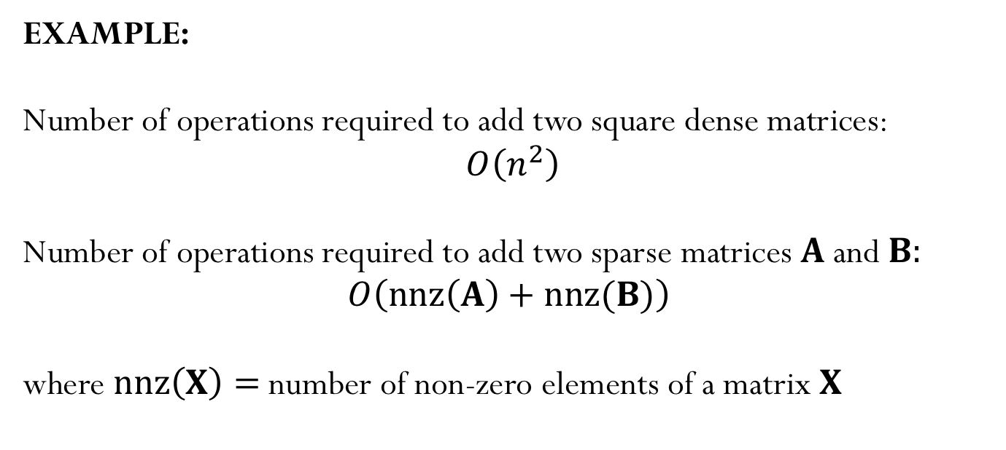
Sparse Matrices
EXAMPLE:
Number of operations required to add two square dense matrices:
$O\left(n^{2}\right)$
Number of operations required to add two sparse matrices $A$and $B:$
$$O\left(nnz\left(A\right)+nnz(B)\right)$$
where $nnz\left(X\right)=$number of non-zero elements of a matrix $X$

Slide 27
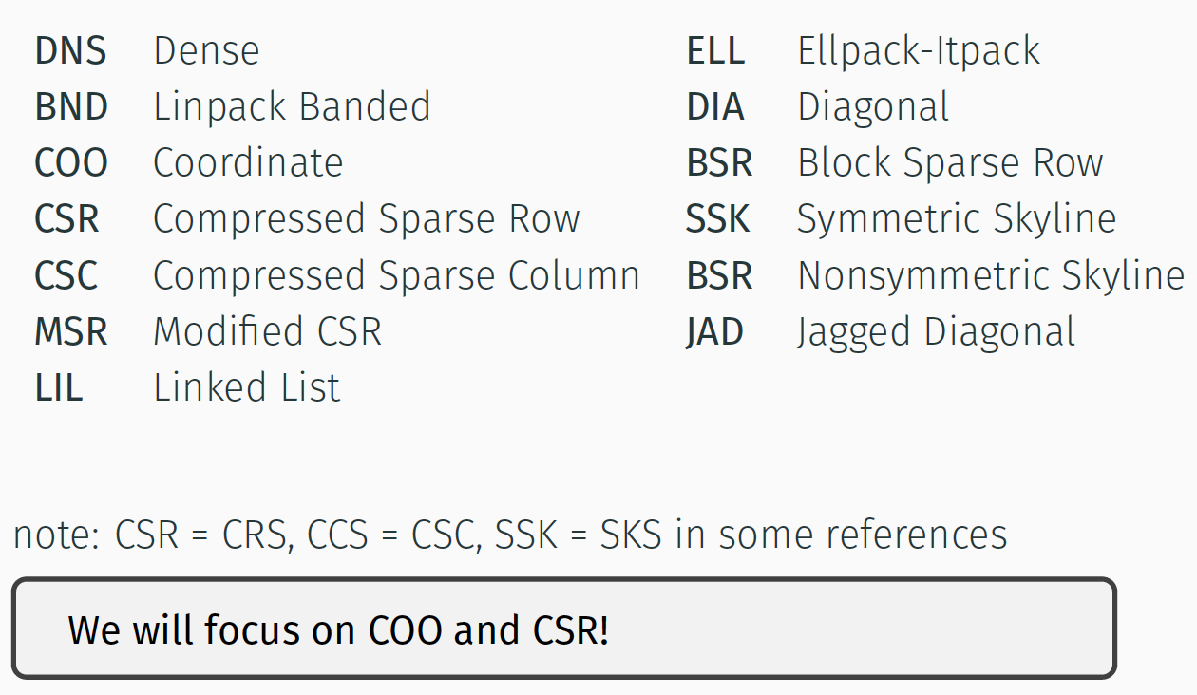
Popular Storage Structures

Slide 28
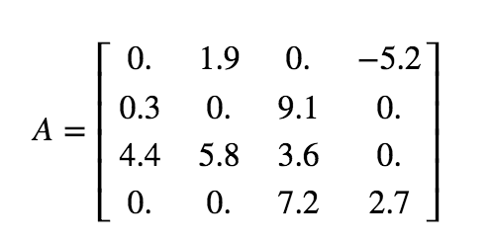
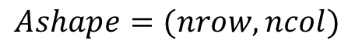
Dense (DNS)
$$Ashape=(nrow,ncol)$$
Row 0
Row 1
Row 2
Row 3
Simple
Row-wise
Easy blocked formats
Stores all the zeros

Slide 29
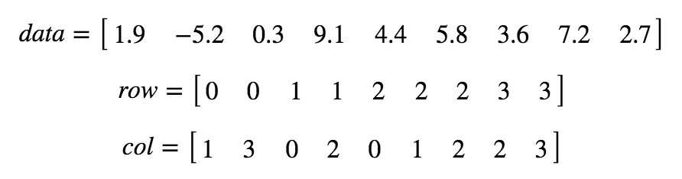
Coordinate (COO)
Simple
Does not store the zero elements
Not sorted
row and col: array of integers
data: array of doubles

Slide 30
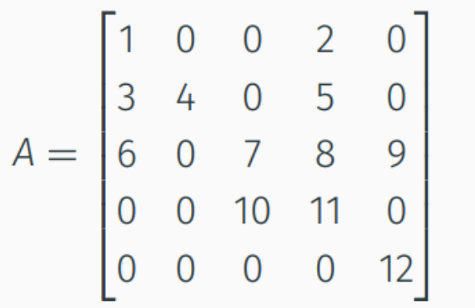
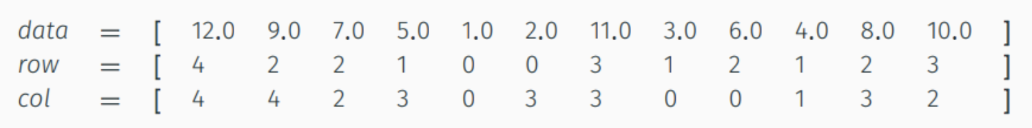
Iclicker question
How many integers are stored in COO format ($A$has dimensions $n×n$)?
A)$nnz$
B) $n$
C) $2 nnz$
D) $n^{2}$
E) $2 n$

Slide 31
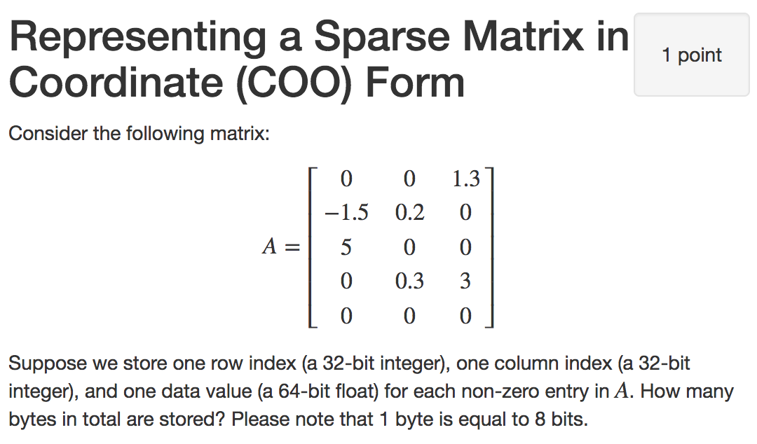
Iclicker question
56 bytes
72 bytes
96 bytes
120 bytes
144 bytes

Slide 32
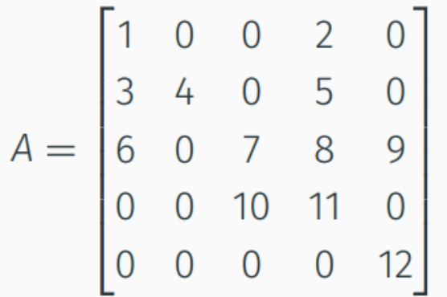
Compressed Sparse Row (CSR)
$$0 1 2 3 4 5 6 7 8 9 10 11$$
Row 0
Row 1
Row 2
Row 3
Row 4
Row offsets
$$nnz(A)$$

Slide 33
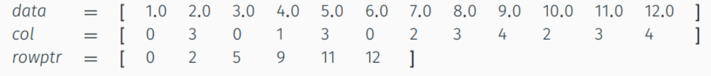
Compressed Sparse Row (CSR)
Does not store the zero elements
Fast arithmetic operations between sparse matrices, and fast matrix-vector product
col: contain the column indices (array of $nnz$integers)
data: contain the non-zero elements (array of $nnz$doubles)
rowptr: contain the row offset (array of $n+1$integers)

Slide 34
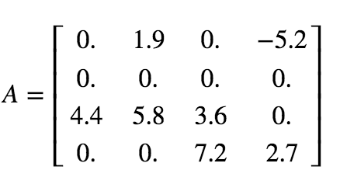
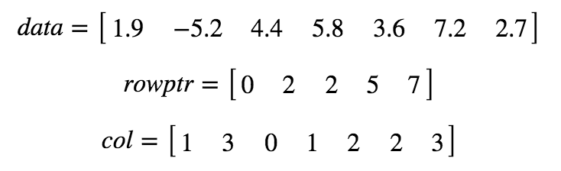
Example - CSR format
Notes:
3

